Slide 1
Deadlocks Lesson 1 Prevention & Avoidance
David Liu
Fall 2021, Spring 2022

Slide 2
Learning Outcomes
Illustrate how deadlock can occur when mutex locks are used
Define the four necessary conditions that characterize deadlock
Identify a deadlock situation in a resource allocation graph
Evaluate the four different approaches for preventing deadlocks
Apply the banker’s algorithm for deadlock avoidance
Apply the deadlock detection algorithm
Evaluate approaches for recovering from deadlock

Slide 3
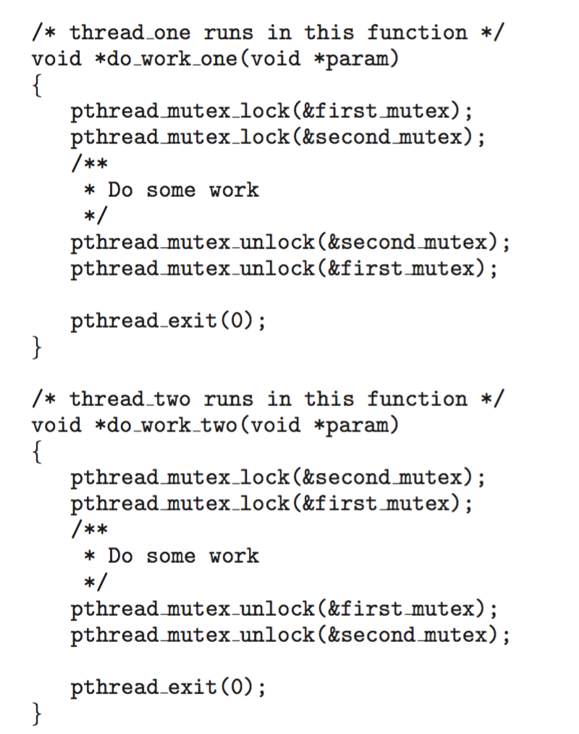
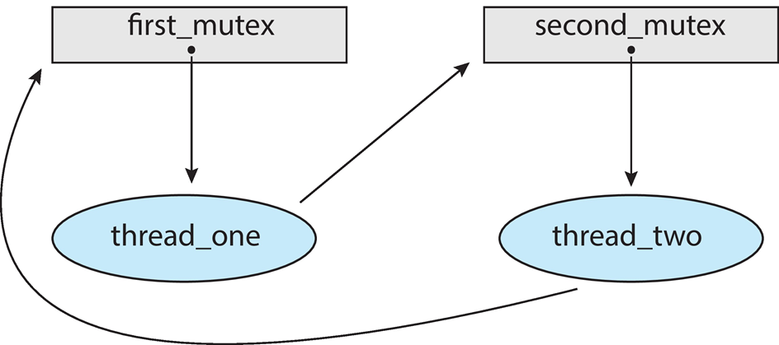
Deadlock in Multithreaded Application
Resource allocation graph

Slide 4
Deadlock Conditions
Deadlock can arise if four conditions hold simultaneously.
Mutual exclusion: only one process at a time can use a resource
Hold and wait: a process holding at least one resource is waiting to acquire additional resources held by other processes
No preemption: a resource can be released only voluntarily by the process holding it, after that process has completed its task
Circular wait: there exists a set {P₀, P₁, …, P_{n}} of waiting processes such that P₀ is waiting for a resource that is held by P₁, P₁ is waiting for a resource that is held by P₂, …, P_{n–1} is waiting for a resource that is held by P_{n}, and P_{n} is waiting for a resource that is held by P₀.

Slide 5
Resource-Allocation Graph
A set of vertices V and a set of edges E.
V is partitioned into two types:
P = {P₁, P₂, …, P_{n}}, the set consisting of all the processes in the system
R = {R₁, R₂, …, R_{m}}, the set consisting of all resource types in the system
request edge – directed edge P_{i} → R_{j}
assignment edge – directed edge R_{j} → P_{i}
CPU cycles, memory space, I/O devices

Slide 6
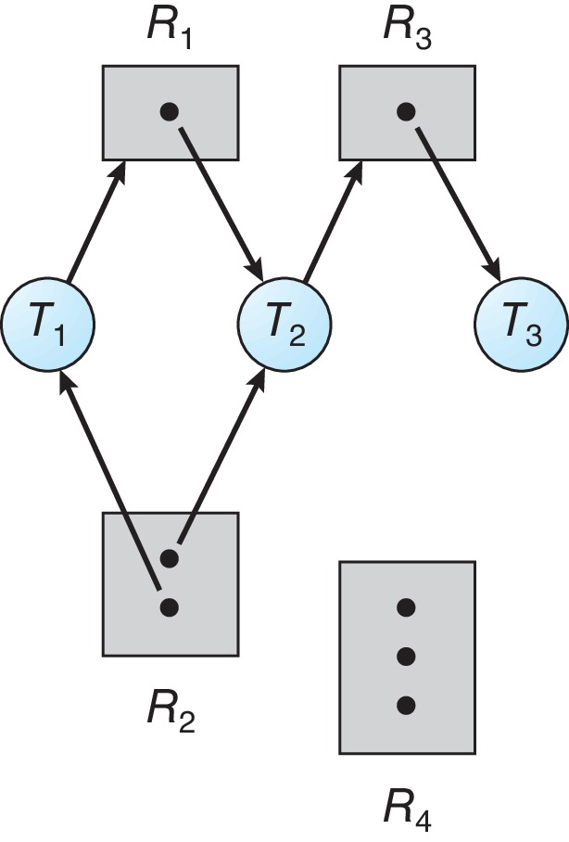
Resource Allocation Graph Example
One instance of R1
Two instances of R2
One instance of R3
Three instance of R4
T1 holds one instance of R2 and is waiting for an instance of R1
T2 holds one instance of R1, one instance of R2, and is waiting for an instance of R3
T3 is holds one instance of R3
request edge – directed edge Pi → Rj
assignment edge – directed edge Rj → Pi

Slide 7
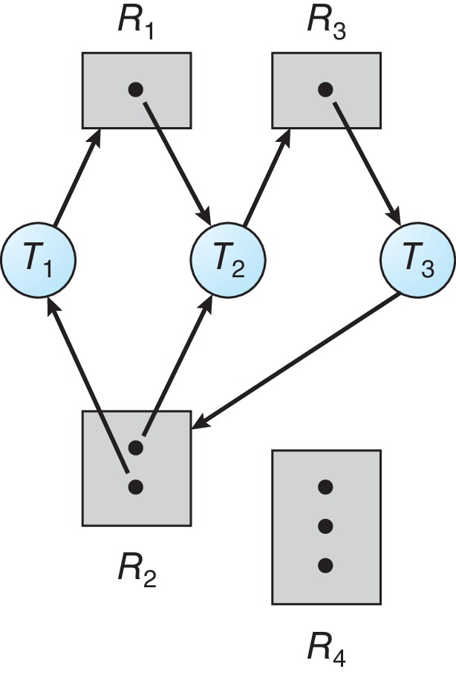
Resource Allocation Graph With A Deadlock
request edge – directed edge Pi → Rj
assignment edge – directed edge Rj → Pi

Slide 8

Graph With A Cycle But No Deadlock
request edge – directed edge Pi → Rj
assignment edge – directed edge Rj → Pi

Slide 9
Basic Facts
If graph contains no cycles ⇒ no deadlock
If graph contains a cycle ⇒
if only one instance per resource type, then deadlock
if several instances per resource type, possibility of deadlock

